Slide 1
Custom bootcamp ida (week-6)
Shivam Jindal

Slide 2
Azure machine learning
What is Machine learning and its uses in daily life ?
Types of machine learning algorithms :
Supervised
Unsupervised
Semi-supervised
Reinforcement
Overview of Azure ML Studio
Notebooks and Pipelines
Azure ML Designer

Slide 3
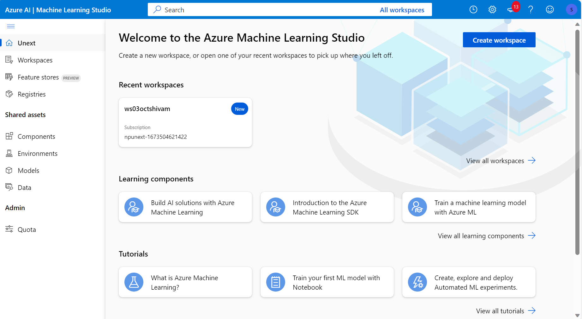
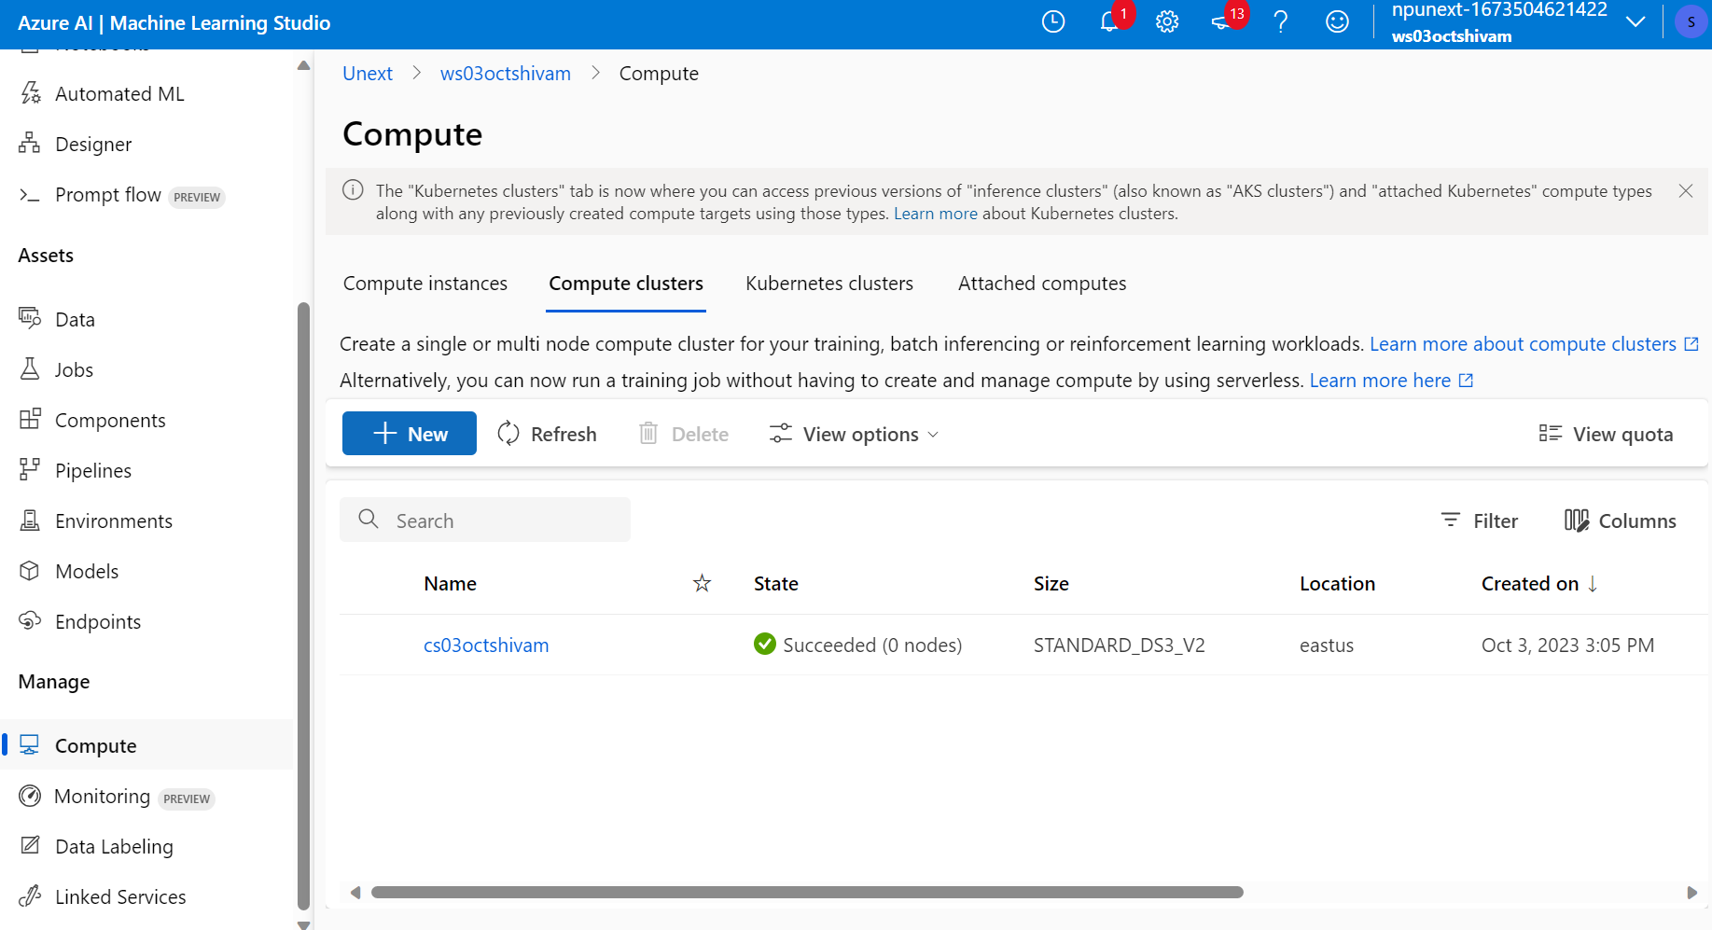

Slide 4
DAY 2 OF AZURE MACHINE LEARNING
Azure ML Studio Pipelines
Tune model Hyperparameters
Automated ML

Slide 5
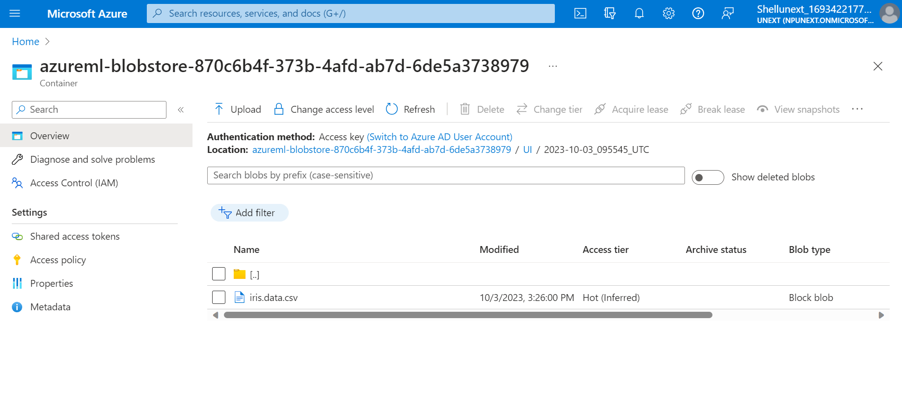
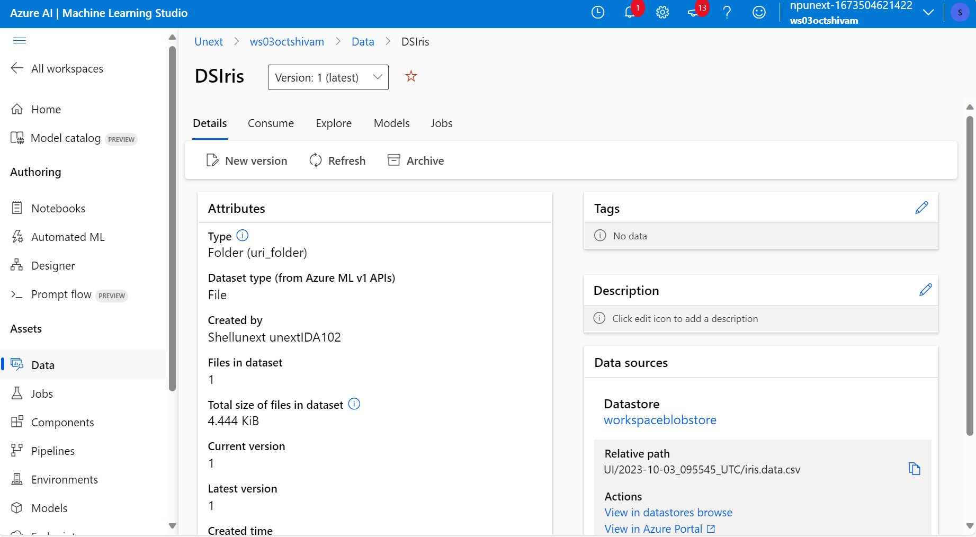

Slide 6

THANK YOU

